Slide 1

CREDIT CARD CUSTOMER ANALYSIS
DOAN NHU DO

Slide 2
AGENDA:
INTRODUCTION
METHODOLOGY OVERVIEW
CODING ON NOTEBOOK
Q&A

Slide 3





INTRODUCTION
Objectives:
Customer behavior.
Connections among different demographic, financial, and product-related variables.
Notes:
This endeavor involves conducting a thorough examination of a credit card dataset obtained from Kaggle, harnessing the capabilities of data visualization and statistical analysis methods within Python libraries: Pandas and Seaborn.
The objective is to reveal valuable insights into customer behavior and investigate the connections among different demographic, financial, and product-related variables within the dataset.

Slide 4

METHODOLOGY OVERVIEW
Step 1: Perform exploratory data analysis to understand the data's structure, identifying key variables and potential patterns . Address missing or inconsistent data through cleaning and preprocessing.
Step 2: Apply statistical methods and visualization techniques to uncover insights.
Step 3: Depending on the goals, I might use machine learning algorithms for predictive modeling or clustering.

Slide 5
CHARTS FROM NOTEBOOK

Slide 6
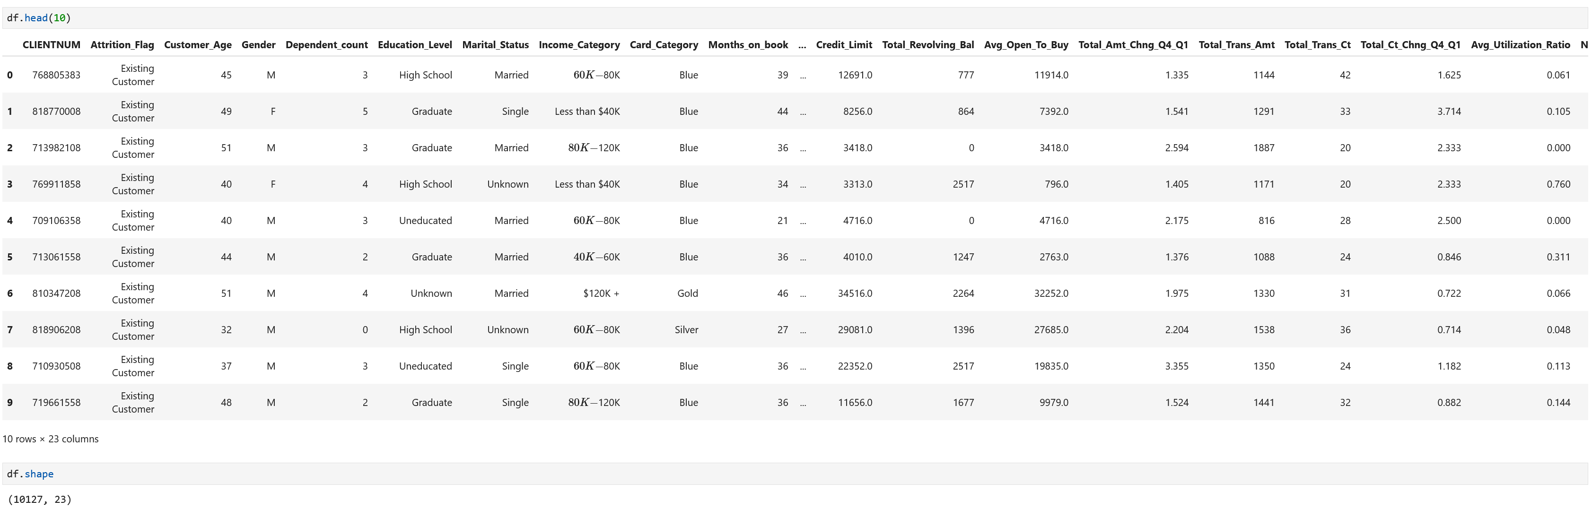
Data Structure

Slide 7
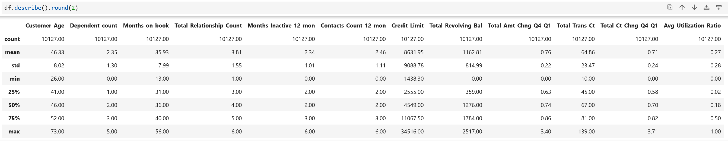
Statistics for dataset

Slide 8
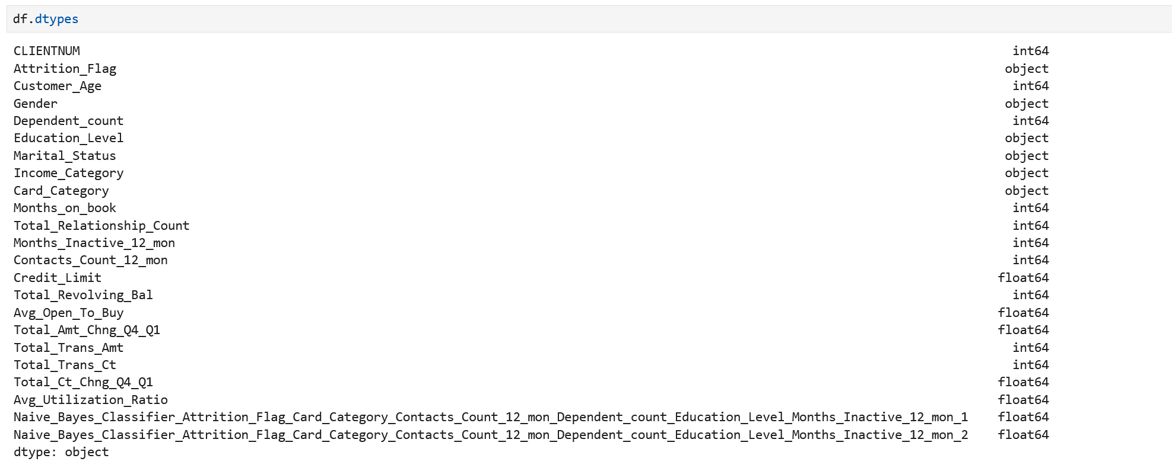
Data types
Notes:
6 object/category data type
17 numeric data type

Slide 9


Slide 10
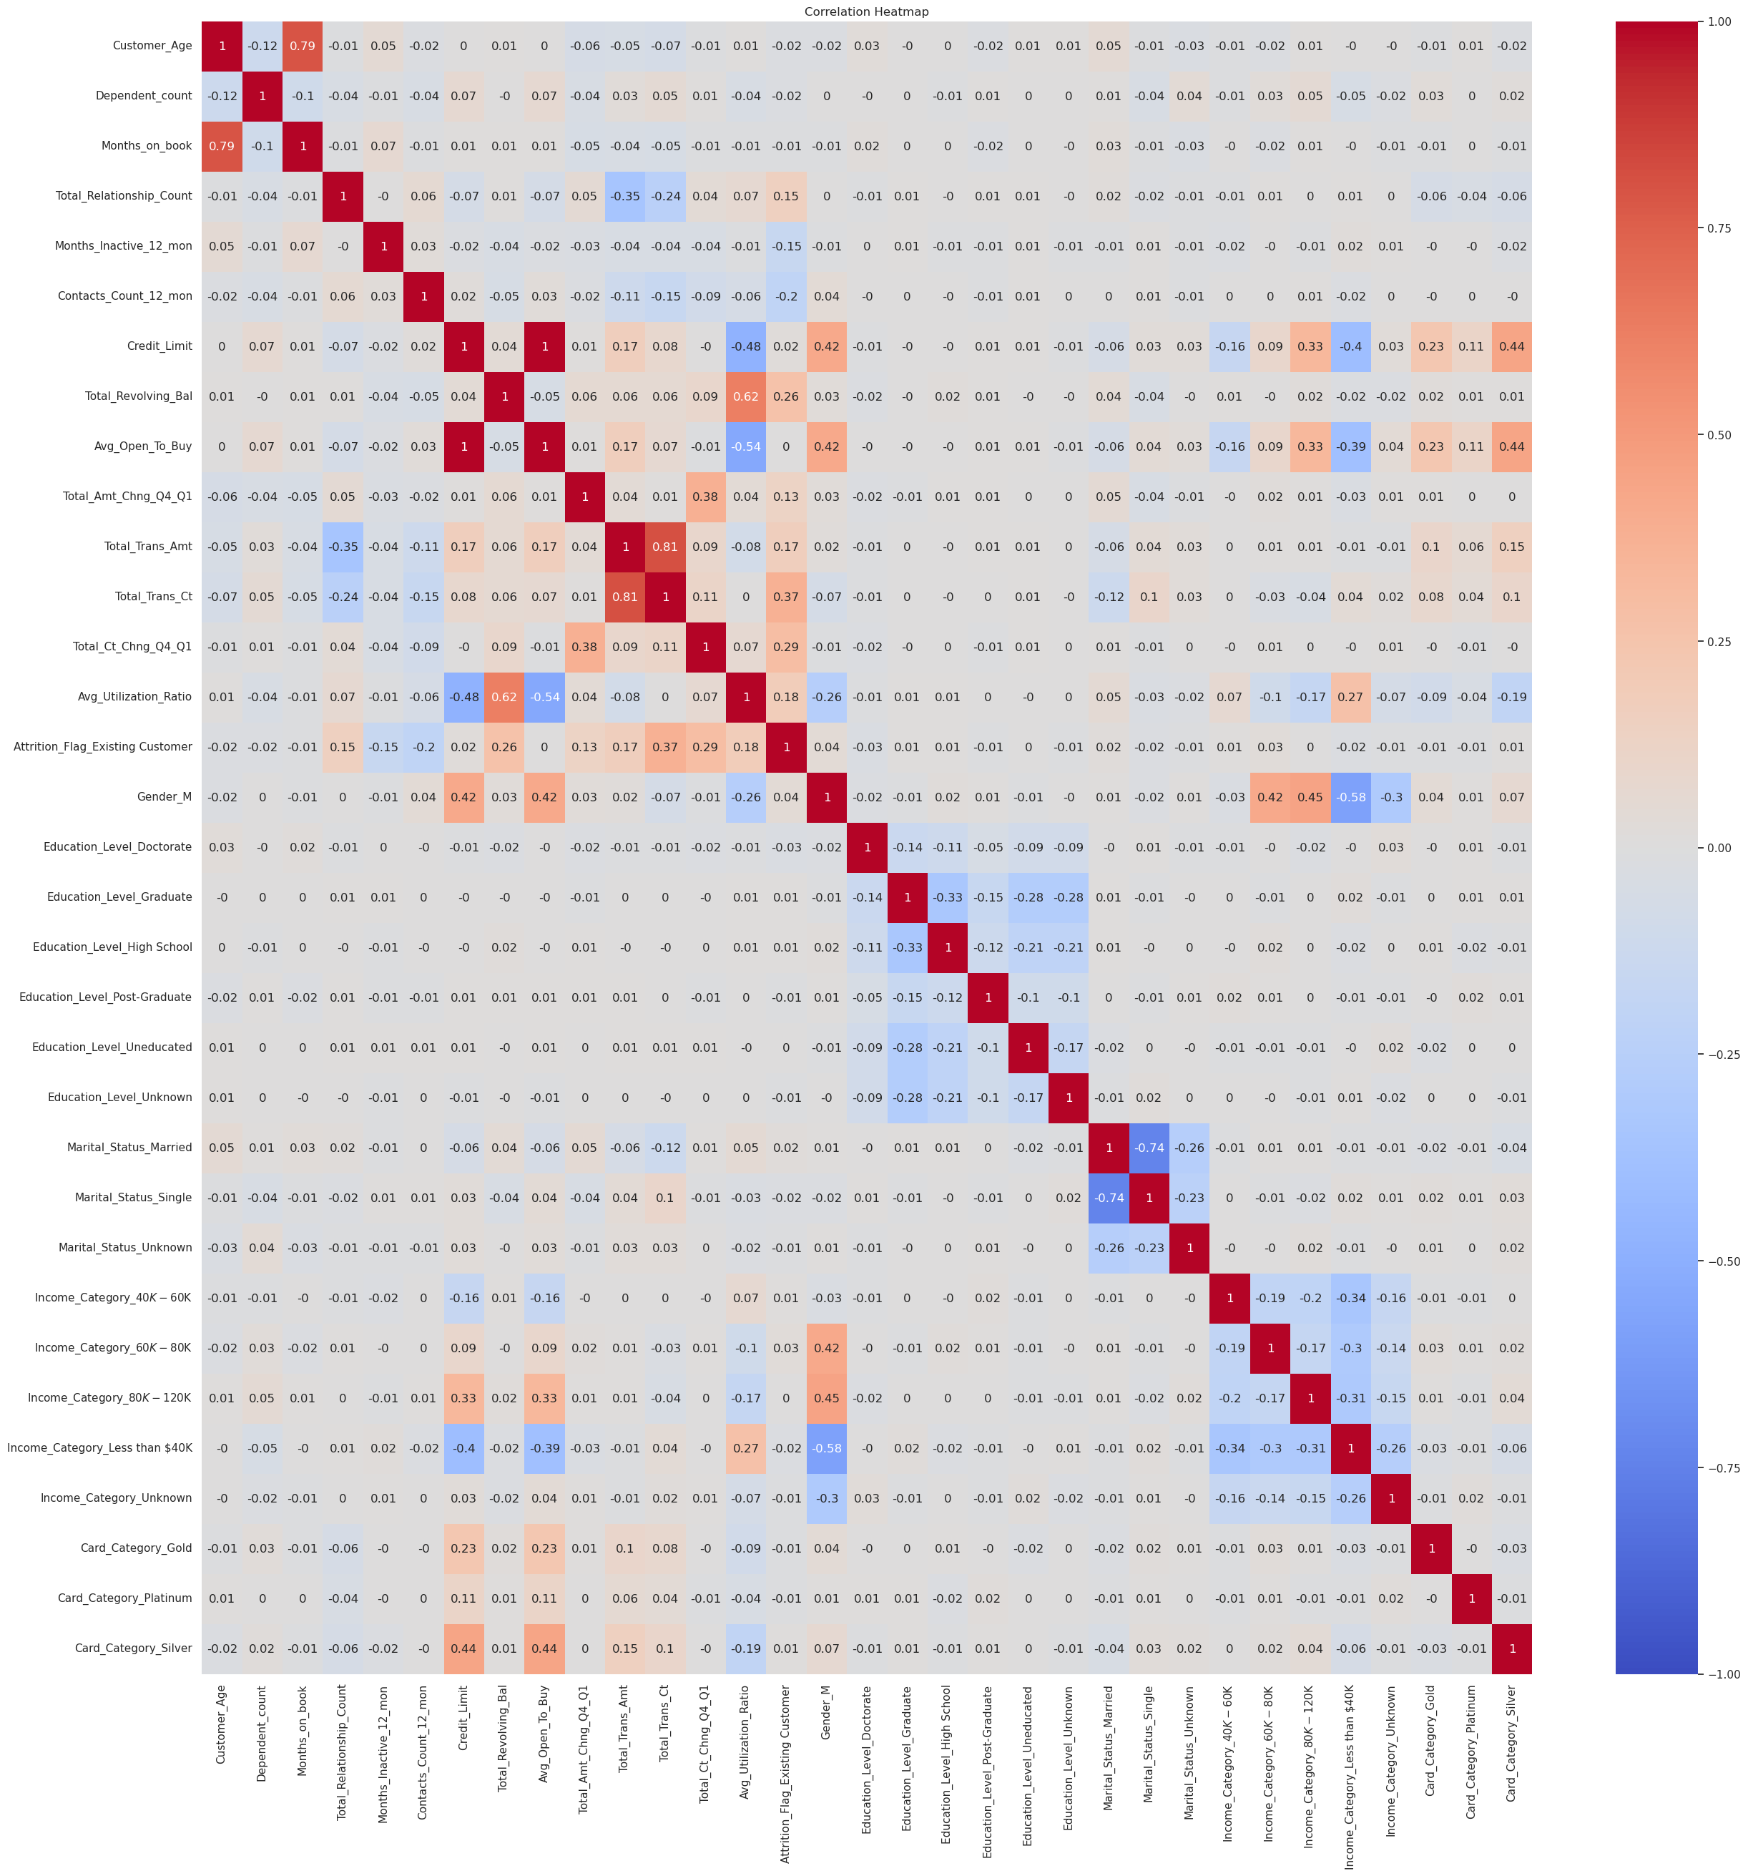

Slide 11
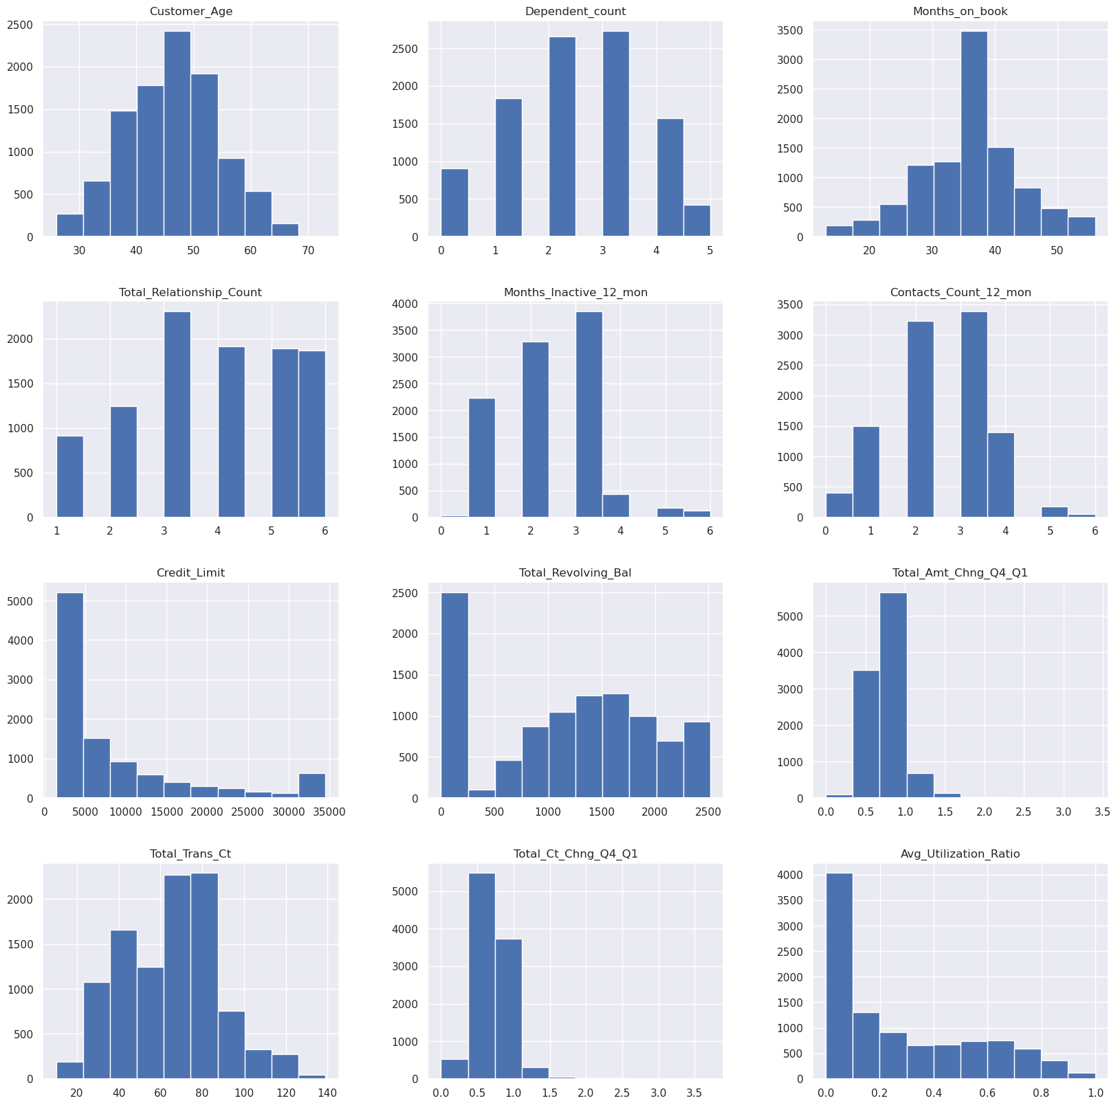

Slide 12
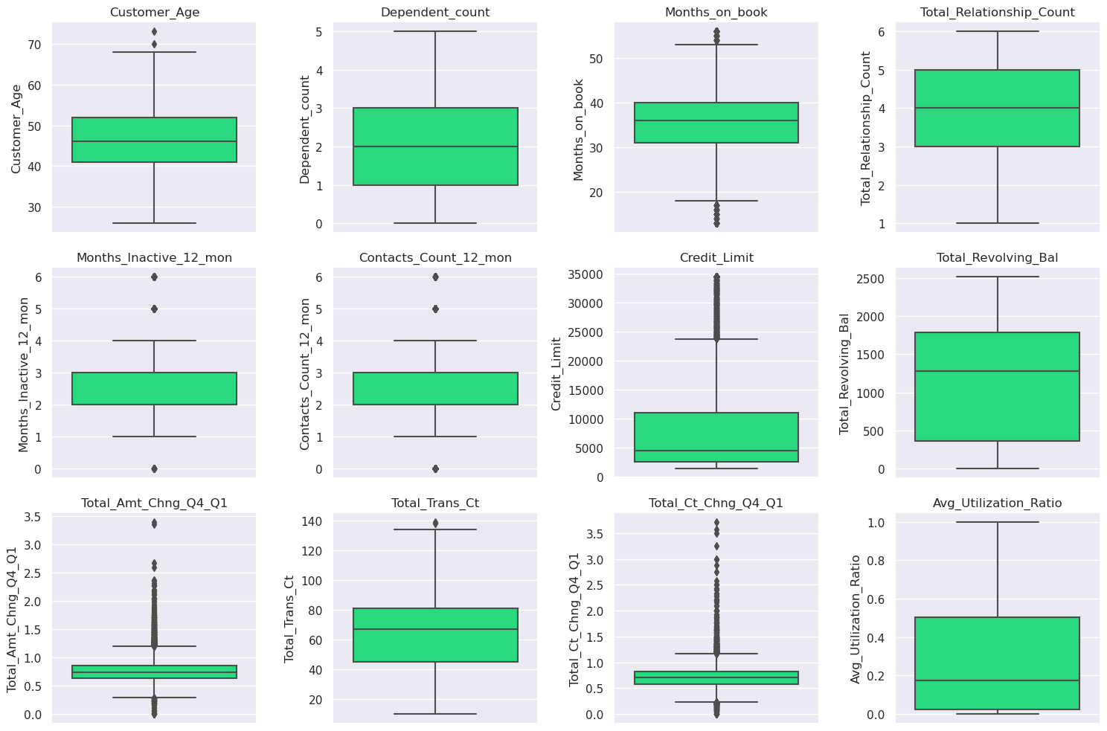

Slide 13
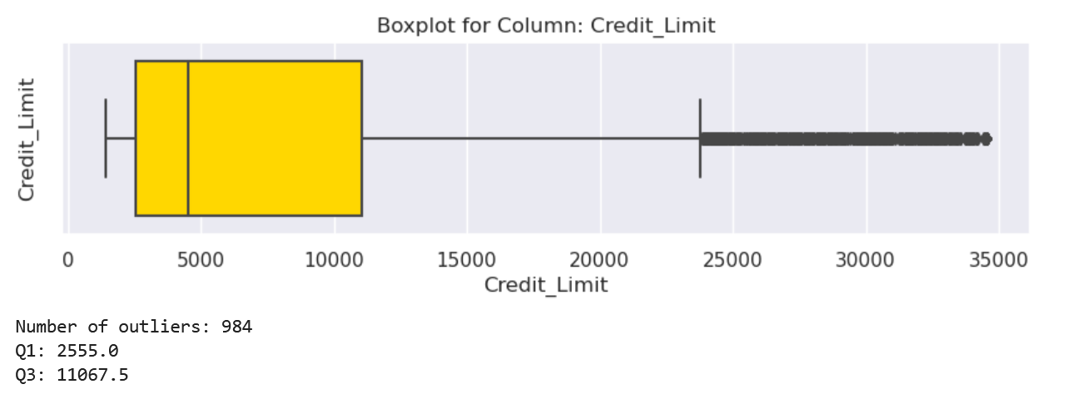
Credit Limit
Notes:
CREDIT LIMIT HAS MORE OUTLIERS DUE TO COMBINING INDIVIDUAL AND BUSINESS ACCOUNTS OR CREDIT LIMIT CHANGE OVER TIME

Slide 14

Months on book
Notes:
PROMOTION OR OFFERS: CUSTOMERS OPEN NEW CREDIT CARDS AND CLOSE SHORT TIME AFTER THAT
THE BANK MAY ACQUIRE ANOTHER BANK, SO CREDIT CARD HOLDERS MAY HAVE LONGER PERIOD

Slide 15
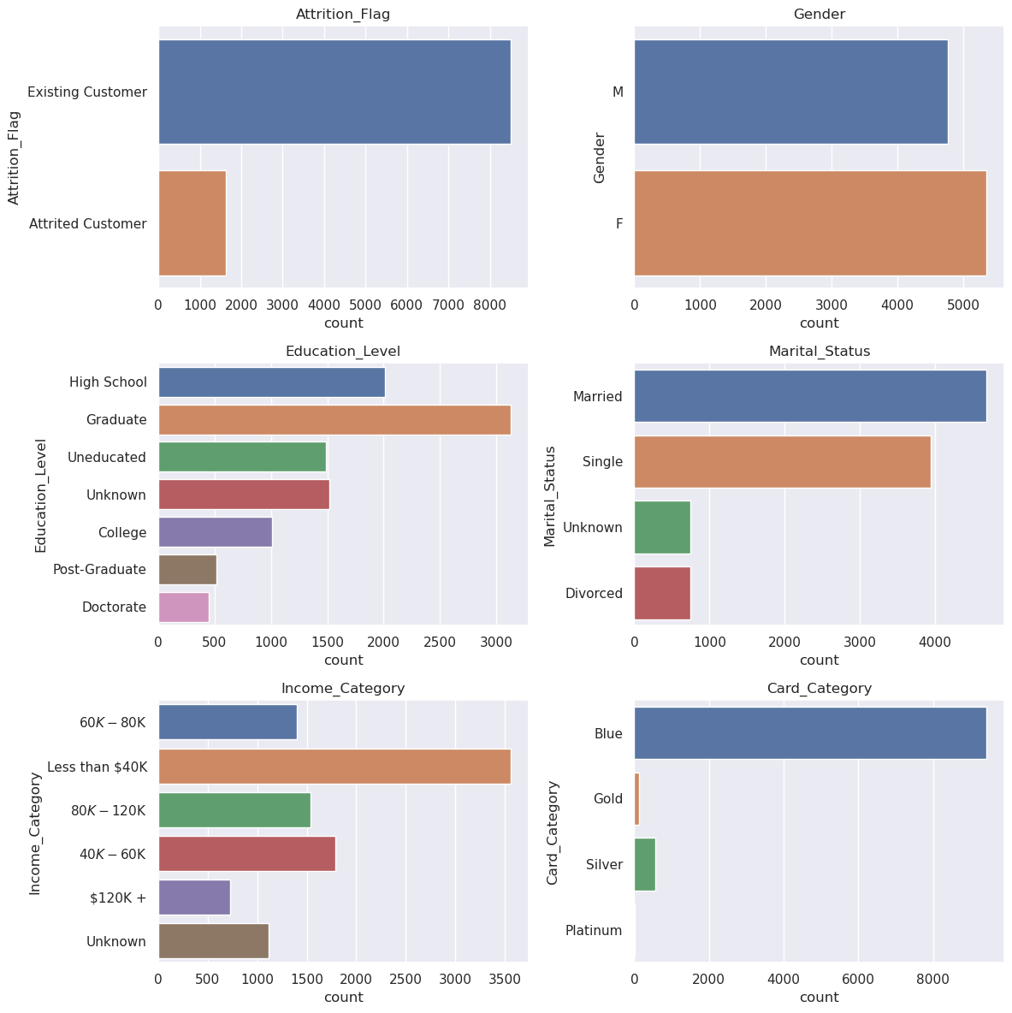

Slide 16
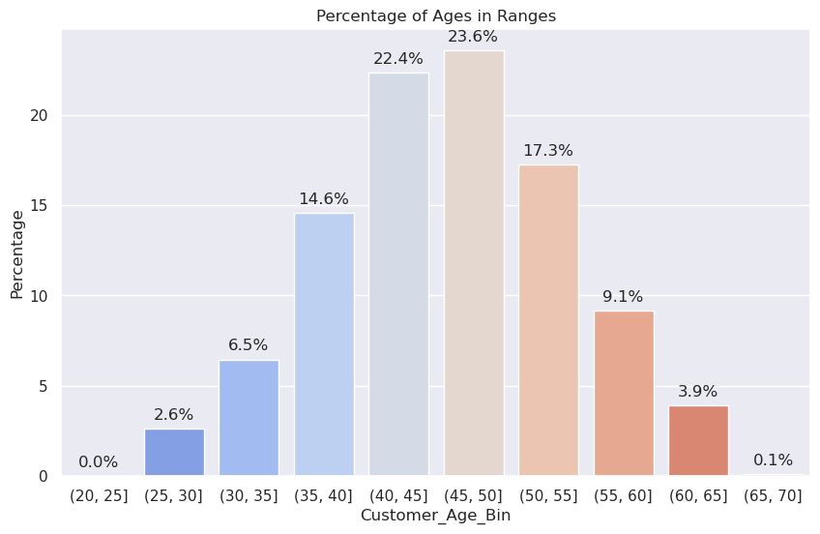
Customer Age

Slide 17
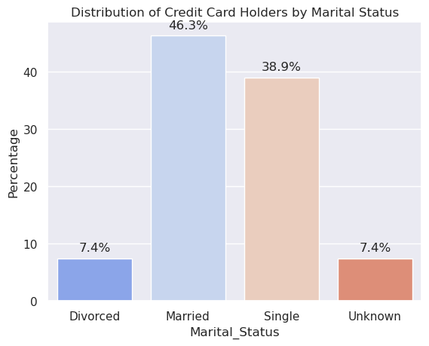
Marital Status

Slide 18
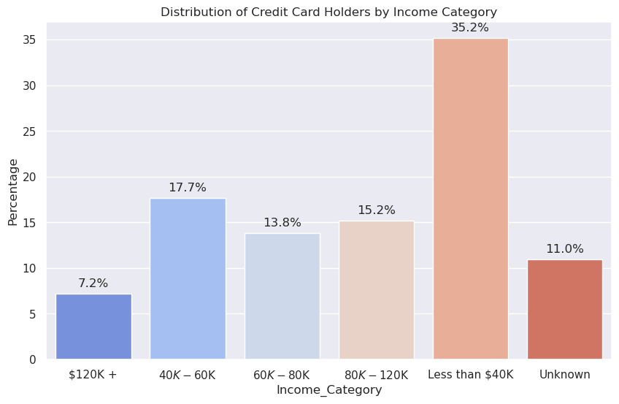
Income Category
Notes:
INCOME ANALYSIS The analysis of the bar chart offers valuable insights into the distribution of credit card holders based on their income.
Within the various income categories, the most substantial segment of credit card holders falls within the income range of "Less than $40K," making up a significant percentage of 35.2%.
This suggests that a notable proportion of credit card holders have lower incomes.
The subsequent noteworthy income category is " $40K-$60K," representing 17.68% of credit card holders.
The income ranges of " $60K-$80K" and " $80K-$120K" closely follow, with percentages of 13.8% and 15.2%, respectively.
These findings indicate that a considerable number of credit card holders belong to the middle-income brackets.
The highest income category of " $120K+" accounts for 7.2% of credit card holders, signifying a smaller proportion of individuals with higher incomes.
Finally, the "Unknown" income category represents 11% of credit card holders, indicating a portion of customers with undisclosed or unspecified income information.
Recognizing the distribution of credit card holders by income category assists financial institutions in tailoring their services, benefits, and credit limit offerings to align with the financial profiles and needs of specific income segments.

Slide 19
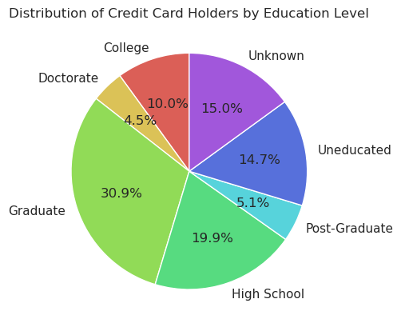
Education Level
Notes:
EDUCATION ANALYSIS:
The clustered bubble chart visually depicts the educational composition of credit card holders.
The predominant segment consists of individuals with a Graduate level of education, comprising 30.9% of all cardholders. This observation suggests that individuals with graduate degrees are likely the primary demographic for credit card ownership and usage, potentially due to higher income levels, enhanced financial literacy, or a combination of both factors.
The second-largest group is comprised of High School-educated cardholders, representing 19.9%. The Uneducated group follows as the third-largest at 14.7%, possibly reflecting lower income levels or a lack of access or awareness regarding credit facilities.
College-educated individuals make up 107% of cardholders, Post-Graduate individuals constitute 5.1%, and Doctorate holders form the smallest group at 4.5%.
An intriguing observation is the notable decrease from the Graduate to Post-Graduate and Doctorate levels. This could suggest that individuals with higher educational qualifications beyond a graduate degree may not find credit cards necessary or may prefer alternative means of financial management.
These insights could prove valuable for credit card companies in shaping their marketing strategies based on education levels.

Slide 20
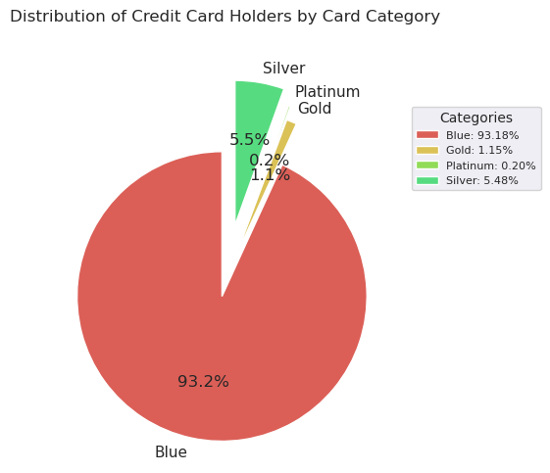
Card Category

Slide 21
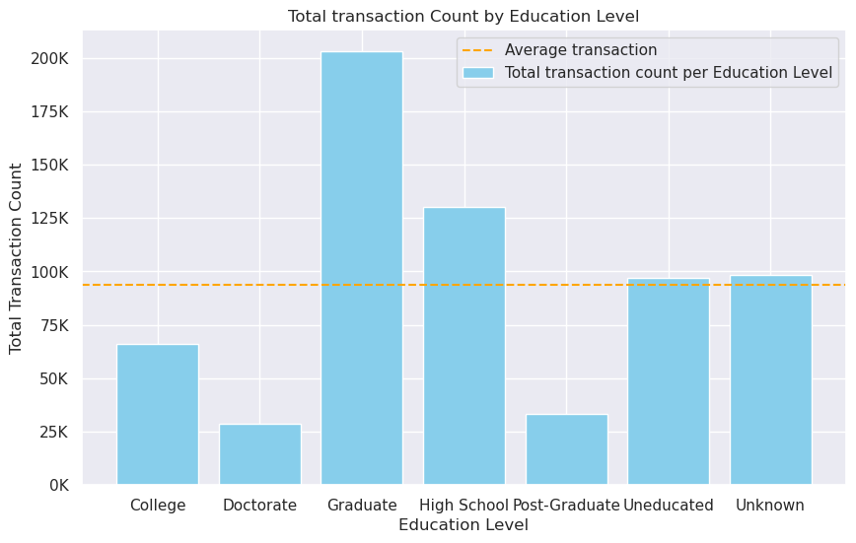
Education and Transaction Count
Notes:
EDUCATION AND TRANSACTION COUNT ANALYSIS:
The Bar Chart offers insights into the variation of transaction frequency across different education levels. Each bar represents an education level, and its length indicates the total number of transactions conducted by credit card holders within that category. When the bar corresponding to the 'Graduate' education level is the longest, it indicates that credit card holders with a graduate degree engage in the highest number of transactions. Conversely, a shorter bar for the 'Doctorate' education level suggests that customers educated up to the doctorate degree have fewer transactions. Analyzing these patterns empowers credit card companies to tailor their strategies and services to meet the specific needs of various education level segments. This could involve offering distinct incentives or card benefits to stimulate increased transaction activity in segments where it is comparatively lower.

Slide 22
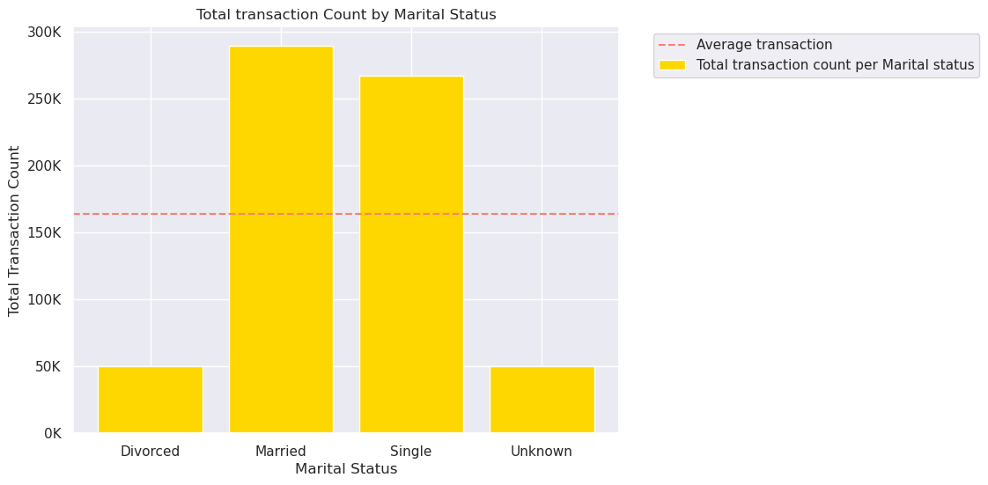
Marital Status and Transaction Count

Slide 23
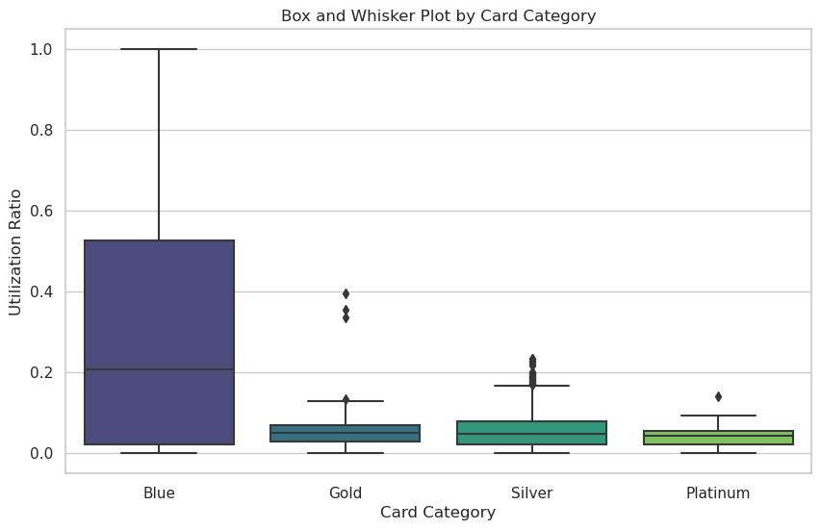
Card Category and Utilization Ratio
Notes:
CARD CATEGORY AND UTILIZATION RATIO ANALYSIS:
The box-and-whisker plot provides valuable insights into the usage patterns of credit cards across various card categories.
Among 'Blue' card holders, the utilization ratios exhibit the widest range, with the upper whisker reaching as high as 1. This suggests that some users in the 'Blue' card category have nearly fully utilized their credit limits. However, the median is relatively low at 0.2, indicating that half of 'Blue' card holders have a utilization ratio below this value.
In contrast, the 'Gold,' 'Platinum,' and 'Silver' card categories show considerably lower maximum utilization ratios (upper whisker at 0.13, 0.09, and 0.16, respectively). The median values for these categories are also much lower than that of the 'Blue' card category, suggesting that card holders in these categories generally use a smaller proportion of their credit limits.
It's noteworthy that the 'Blue' card category, typically associated with a lower-income segment, demonstrates a higher utilization ratio compared to the premium 'Gold,' 'Platinum,' and 'Silver' card categories. This observation could imply distinct spending behaviors among card holders in different income brackets or varying strategies employed by the credit card company for different card categories.

Slide 24
THANK YOU

